Slide 1
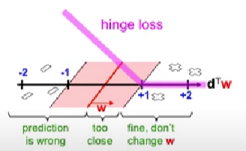
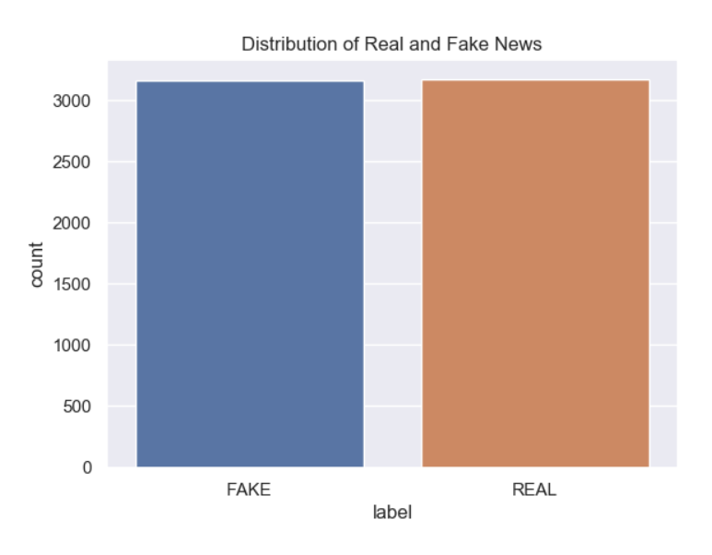
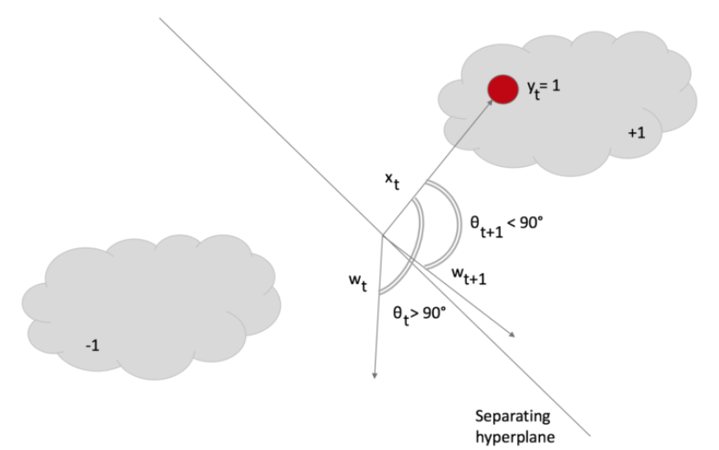
METHODOLOGY
1. We will collect a set of data marked as factual or false. We have to build our own dataset here as there is not a single dataset available that is in the Indian context or uses languages other than English.
2. Features must be extracted from the text data through methods such as bag of words, TF-IDF, or word embedding.
3. We will train a machine-learning model using the extracted features and the labeled data.
4. Fine-tuning and evaluation of the model can be done through cross-validation, confusion matrix, precision, recall, and f1-score.
5. The model will then be tested with unseen data and any necessary adjustments can be made.
We carry out the above steps for Hindi and English Language data sets. Finally, the interface is built on Streamlit which is an open-source Python library that makes it easy to build interactive web applications for data science and machine learning. One of the key features of Streamlit is its ability to automatically update the application in real-time as we make changes in the code. This makes it easy to experiment and iterate quickly, without having to restart the application or reload the browser.

Slide 2

SOCIETAL IMPACT/ NOVELTY
FUTURE SCOPE
1. Enhanced Trust and Confidence: Fraud can erode trust and confidence in financial institutions, e-commerce platforms, and other systems that involve transactions. Organizations can demonstrate their commitment to security and protect their customers' interests by implementing effective fraud detection systems. This, in turn, fosters trust and confidence in society, encouraging individuals and businesses to participate in economic activities without the fear of falling victim to fraud.
2. Reduced Financial Losses: Fraud detection systems have a significant societal impact by mitigating financial losses for individuals, businesses, and governments. By minimizing financial losses, fraud detection systems help protect individuals' savings, safeguard businesses' assets, and reduce the burden on government resources.
1. Deterrence and Prevention: Fraud detection systems act as a deterrent to potential fraudsters. Knowing that their activities are being monitored and swiftly detected, individuals with malicious intent are less likely to engage in fraudulent behavior. This helps maintain the integrity of financial systems and markets.
2. Efficient Resource Allocation: Fraud detection systems streamline the process of identifying and investigating fraudulent activities, enabling efficient allocation of resources to genuine transactions and legitimate activities. By reducing the time and effort required for manual fraud investigations, these systems free up resources that can be utilized for societal development, such as improving public services, infrastructure, healthcare, or education.

Slide 3

THANK YOU

